Slide 1
Global ID/EPH
August 2020

Slide 2



Our Promise:
People need help obtaining better, more proactive, personalized care. With HCB analytics and CVS Health’s human touch we will create a new approach to health care.
EXPERIENCE
FOUNDATIONAL
A coordinated experience
that wows you
Insight to help you
achieve your goals
Integration that gives you access to everything
Curates and coordinates all messages we send you
Remembers and learns from all interactions you have with us
Predicts and engages through Next Best Action
Synthesizes everything we know about you
Understands your goals and preferences
Provides you with actionable insight
Identifies you across time, space and products
Never forces you to register more than once
Reconciles and conforms data from many sources
Security and Stability

Slide 3
What is Global Identity?
A consistent and seamless knowledge of an individual’s identity across lines of businesses that will improve the constituent experience and increase business agility.
We believe providing an individual a Global Identity will improve the constituent experience and increase business agility.
We will provide each constituent a single identity for each relationship with CVS Health and recognize it across time and systems of engagement.
We will support a consistent and seamless experience for all persons interacting with the CVS Health ecosystem.
We will protect constituent data and privacy.
We will manage risk to CVS Health and our constituents, by providing the least intrusive experience using most adaptable methods available.
We will make it easy for applications to implement identity services in hybrid ecosystems.
Global Identity
To…
“We always know you”
From…
Multiple identities
Individualization
Managed process to handle real time fallout, error correction and more
Well understood business relationships over time and space
Seamlessly map identity keys between different systems and data sources

Slide 4
ENTERPRISE PERSON HUB (EPH) / GLOBAL ID
570M+
GLOBAL ID
Provides consistent and seamless knowledge of an individual’s identity across lines of businesses that will improve the constituent experience and increase business agility.
Resolves identity of a ‘person’ based on demographic and other identity data.
Assigns and manages a unique Global ID for an ‘individual’.
All pervasive, extensive integration with large number of applications powering foundation business capabilities and new innovative initiatives like Customer 360, Advanced deep analytics , Enterprise DUR, Integrated Specialty, Digital/Mobile etc..
Tier 1A - Active / Hot-Standby platform
1.7B+
3.4B+
SOURCE RECORDS
TRANSACTIONS PER YEAR
7.5M+
250
SEARCHES PER DAY
MILLI SECOND AVG RESPONSE TIME
1.5M+
800K+
SOURCE UPDATES PER DAY
GID EVENTS PER DAY
³⁰⁺
ENTERPISE CONSUMERS ACROSS PBM, RETAIL, SPECIALITY, AETNA,DIGITAL,IPP,A4L,HCB
¹²
SOURCES ACROSS MAJOR ENTERPRISE LOBS - PBM, RETAIL,HCB,DIGITAL, SPECIALITY

Slide 5

Global ID & EPH
Source systems in each domain send member/patient demographic data to EPH for the purposes of matching
EPH matches source records using advanced probabilistic matching techniques and identifies same ‘individual’ within / across source systems
EPH manages Global Identifier assignment for an ‘individual’
EPH is NOT the system of record for demographic data. This data is only used for matching and search functions (Applications must go to domain systems for data needs) Access to the data is protected by system enforced security controls
EPH Search Services support search by source or global identifier or demographics. Associated identifiers / demographics for matching individual(s) returned to consumers with appropriate context and authorization.
Enterprise Person Hub (Identity Master Index and Global Identity)
1
RXCLAIM -PBM
1
Identity Resolution
Global Identifier Management
HCB
> 700 million records
3
>139 million records
2
Individuals
2
QL-PBM
>390 million records
1234A34
B547358
Coram
3
> 0.2 million records
Retail Rx
>250 million records
Accordant
4
839CV73
4
> 0.9 million records
>22 million records
Novologix
1
> 0.3 million records
Specialty
5
>10 million records
EPH Search Services
> 3.4b transactions / year
> 1.7b source records
5

Slide 6
Enterprise Person Hub
Enterprise Person Hub (EPH) is aimed at tracking a person across all lines of business within CVS Health leveraging demographic data. Consuming systems have clarity when accessing person-related data points.
Source Systems
Rx Connect
Consumers
Real Time & Batch
Rx Claim
Batch
Digital - CMT
Specialty
QL
Batch
ECCR – Rx DW
HEE (EOMS)
CATS
Real Time
HBS SPARCS
Real Time
Links/QL – Rx Claims
Minute Clinic
EMR
Batch
ESL - EDW
Rx Connect
Coram
Batch
Accordant
Batch
Portals – Specialty, PBM, Retails
Novologix
Batch
IMI Aetna
Real Time
Record Volume
Retail Rx ~ 257 Million | PBM ~ 1 Billion | Specialty ~ 10 Million | Minute Clinic ~ 26 Million | Coram ~ 20 Thousand (infusion only) | Accordant ~ 840 Thousand | Novologix ~ 303 Thousand | IMI Aetna ~ 135 Million
EPH provides a single, Enterprise-wide view of a person across CVS Health Lines of Business

Slide 7
Enterprise Person Hub (EPH)
EPH is the cornerstone of the customer eco-system aimed at tracking a person across all participating LOBs within CVS Health. EPH maintains information for over 575 Million Unique Global IDs (Individuals).
46.2M
187K
1.4M
150K
5.2M
231K
60.4M
7.7K
303K
7K
88K
21.7M
Channel | Member Base
Aetna | 20,415,630
Retail | 74,573,755
Specialty | 1,033,121
Caremark | 96,412,646
59K
4.7M
8.9M
Consumers
Digital - CMT
Integrated Customer Experience
Follow me logic
Specialty Connect
Portal – Specialty, PBM, Retail
IPP
Pharmacy Advisor
ECCR – Rx DW
HEE (EOMS)
Clinical Data Repository
PBM Adjudication
A4L – Acct for Life
DUR
Client Reporting
EPH provides a single, Enterprise-wide view of a person across CVS Health Lines of Business

Slide 8
Global ID consumers
Global ID is being sent to some of the recent new EPH consumers and more are planned
Source Systems
Rx Connect
Consumers
Real Time & Batch
Rx Claim
Batch
UDF
Account for Life – A4L
QL
Batch
Individual Profile and Preferences - IPP
Current
CATS
Real Time
HBS SPARCS
Real Time
Clinical Platform
Pharmacy Advisor
EMR
Batch
Coram
Batch
Active Health
Health Hub
Accordant
Batch
Planned
Kidney Care
Diabetes Care
Novologix
Batch
IMI Aetna
Real Time
Multiple potential consumers in discussions
Record Volume
Retail Rx ~ 257 Million | PBM ~ 1 Billion | Specialty ~ 10 Million | Minute Clinic ~ 26 Million | Coram ~ 20 Thousand (infusion only) | Accordant ~ 840 Thousand | Novologix ~ 303 Thousand | IMI Aetna ~ 135 Million
EPH provides a single, Enterprise-wide view of a person across CVS Health Lines of Business

Slide 9
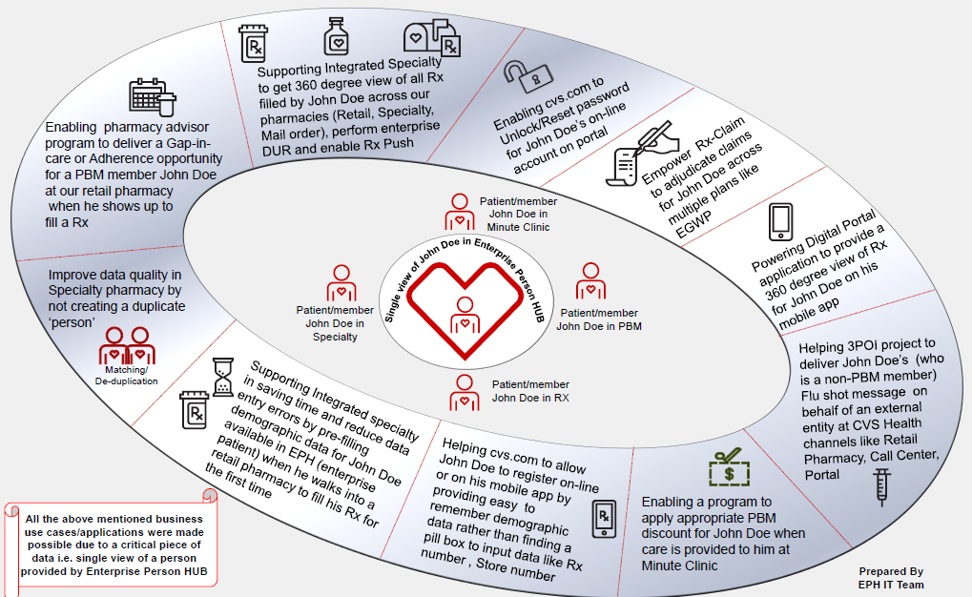
How is EPH currently enabling business transformation?
EPH is leveraged across CVS today by various programs

Slide 10
Conceptual Architecture – Global ID/EPH
Enterprise Person Hub

Slide 11
Global ID/ EPH MDM – Additional Capabilities
To support advanced fine grained management of Privacy Preferences and Consent related to an ‘person’ as per privacy regulations like GDPR, CCPA, etc
Allows for management of consent and profile effectively and efficiently at one place
Consent Module
Householding Module
Provide relationship and grouping of individual.
Enable monetization and targeting opportunities at a house hold, enable new types of digital and other business processes.
Best Value of truth across all sources of person attributes. Provide trusted single source of truth for Individual demographics and profile for multitude of use cases like registration & operational programs to contact patients
This will enable extending customer profile with additional important attributes like social media, allergies/conditions, & Privacy preferences
Golden Record Module

Slide 12
What is a ‘household’
EPH uses most recent address and phone data to compare and determine if those person(s) belong to a ‘household’
Address and phone are scored separately and added together to make a final score
Exact matches will score higher, anything less exact will get a lower score based on degree of mismatch. The more the mismatch, lower the score gets
A threshold score is established – Auto Link Threshold. This score determines if 2 records will fall into same household or not – any score equal to or more than this threshold score is determined a match and they will belong to same ‘household’
A ‘person’ record can be in one and only one ‘household’ at any time
It uses most recent (active in EPH parlance) of the 2 types of addresses in EPH – Primary, Non-Primary and 2 types of Phones – Primary and Non-Primary
If the active Primary of one matches to active non-primary of another or vice versa, it is treated as a match
Address and Phone are compared independently first and together later to arrive at a final score
No other data is available currently in EPH other than above to compare and determine a ‘household’
If 2 records have no matching active address/phone data, they don’t come together as a ‘household’ regardless of match of other data – FN, LN, DoB, Gender etc.
Any address/phone data that is not available on either record is treated as ‘missing’ and gets a score of ‘Zero’
If one record has address and phone data and second record has no address and phone data, they get a score of ‘zero’ and so will not come together into a ‘household’
If both records have no phone and address data, they get a score of ‘zero’ and so will not come together into a ‘household’
As EPH gets updates to ‘person’ data from sources it will re-match in real-time and adjust ‘households’ accordingly – an existing person record can move out of an ‘household’ or a new person record can come into an ‘household’

Slide 13
Householding Use Cases
There is a request from digital to create an omni-channel experience around care giving relationship. They would like to have a predictive capability leveraging Householding functionality to associate someone from a minor’s household as caregiver of the minor
Longer term need across the enterprise to have a concept of a household ID to handle inclusion of Extracare ID and the need to associate preferences and many other use cases

Slide 14

What is EPH and what it is not!
EPH resolves identity of a ‘person’ based on demographic and other identity data
9 source systems provide person identity data to EPH – RxClaim, QL, RxConnect, HBS, CATS, MC EMR, Novlogix, CORAM and Accordant
EPH provides a cross-reference of system IDs/Keys for the same ‘individual’ within and across above systems
EPH is a ‘registry style’ hub and DOES NOT maintain a ‘golden record’ for an ‘individual’
EPH self-corrects the matching in real-time as better quality data is fed into it via updates from source systems
EPH also assigns and manages a unique Global ID for an ‘individual’ (preferred and alternate Global IDs are managed)
EPH is NOT a system of record for demographic data like Name, Address, Phone Number
EPH does NOT store any transaction data like Scripts, Claims, Eligibility

Slide 15

EPH service catalog
EPH provides 3 major types of services to consumers
Search in real-time and batch modes
Cross-reference in batch
Global ID Update events in near-real time

Slide 16

EPH service catalog - Search
Various type of Searches in real-time/batch modes
Search using fewer demographic attributes and get zero or more matching ‘person’ records – zero or more. Normally used from a front-end manned by an internal CVS personnel to pick the right person from a list. This is available in real-time mode ONLY
Search using more demographic data and get ‘the matching individual’ record – zero or one. Normally used between systems or when you the need to find ‘the person’ within the enterprise or to bounce external demographic data to find matching CVS person/member. This is available in both real-time and batch modes
Provide a system ID (source system ID, Global ID or Preferred Proxy ID) and get matching individual’s IDs and demographics across the enterprise or within some source system(s). Normally used to find same person in another source system or across all source systems in the enterprise. This is available in real-time mode ONLY

Slide 17

EPH service catalog – Cross Reference and Global ID updates
Cross-Reference in batch mode
Provide updates to linkages of records to a ‘person’ – Source system ID to EPH ‘individual’ association
Provide updates to demographic data
This data is typically sent to the data warehouses and UDF
Global ID Updates in near-real time
Send event when a new source record is added to EPH from any source with its Global ID
Send event when a source record is deleted in EPH from any source
Send Split and Merge events when GID changes happen in EPH
Send SourceSplit and SourceMerge events when a Split/Merge happens in the source

Slide 18

What's under the EPH hood?
Matching and Identity resolution
At the core of the EPH is IBM’s Infosphere MDM Software, considered a leader in the master data management space especially for patients, prescriber/provider
EPH uses sophisticated probabilistic matching techniques to resolve identity. This measures the statistical likelihood that 2 records represent same ‘person’ - Edit Distance, Phonetic, Multi-dimensional, False Positive Filter etc.
Attributes like Name (First, Middle, Last, Prefix, Suffix), DoB, Gender, Address(es), Phone Number(s), HIC/RRB# are used in comparison and scoring. If the score is above a particular threshold it is considered a match – same ‘person’
The matching algorithm is conservative and aims to create zero ‘false positives’ which means it may leave some matches on the table. This is due to the nature of business we are in
Manual data stewardship is also supported to merge/link records for any outliers
A robust algorithm refinement process was conducted and approved by business stakeholders in various lines of business before EPH went into production
Global ID management and publishing of events
IBM Infosphere MDM has been extended to assign Global ID and manage changes to the Global ID (both preferred and alternate Global)
Publishing of Global ID change events are also handled by these extensions

Slide 19
Global ID/EPH Questions
Thank You
Questions
Melissa Person-Ashforth
(Melissa.Person-Ashforth@CVSHealth.com)
(Wijen) Nadesan Wijendran
(Nadesan.Wijendran@CVSHealth.com)

